Slide 1
Benchmarking Generative AI Token Use in Cybersecurity Operations
Assignment 2C Presenting new results and findings
Mohamed Zeyada - 11693860
Networks and Security
Supervisor:Dr. Gowri Ramachandran
Cluster 8
IFN712 Research in IT Practice

Slide 2
Research Question (Original and Revised)
Original Research Question (RQ1):
"How does prompt length influence LLM output quality and cost efficiency in SOC/GRC tasks?"
Revised Research Question:
No change - The research question remains the same
Explanation of Refinement:
• v3 Issue: Different tasks for S/M/L variants (introduced confounding variables)
• v4 Fix: Identical tasks across all lengths, only context detail varies
• This ensures RQ1 can properly measure "where quality gains plateau"
Why No Change?
The question accurately captures the core research objective. The refinement was methodological, not conceptual - ensuring scientific rigor in experimental design.

Slide 3
Completed Experiments and Data Collection Work
Platform Implementation (COMPLETE )
• Web-based benchmarking interface deployed
• MongoDB database with 300 prompts loaded
• API endpoints functional for experiment execution
Experimental Runs (COMPLETED )
• 122 runs with multi-judge 7-dimension rubric scoring
• Real LLM evaluations across multiple models
Dataset Development (COMPLETE )
• Generated 300 academic-grade prompts using controlled experiment design
• 100 base scenarios × 3 length variants (S/M/L)
• Token ranges: S (150-250), M (450-550), L (800-1000)
Data Collection Methodology
• BOTSv3 Integration: Real ransomware families (243), DDNS providers (50), event codes
• Scenario Coverage: 150 SOC, 90 GRC, 60 CTI prompts
• Controlled Variables: Task requirements identical across S/M/L
• Independent Variable: Only prompt length varies
Validation (COMPLETE )
• Automated methodology validation: 100% task consistency verified
• Token distribution: 95.3% within target ranges
• Academic integrity: Peer-reviewed data sources integrated

Slide 4
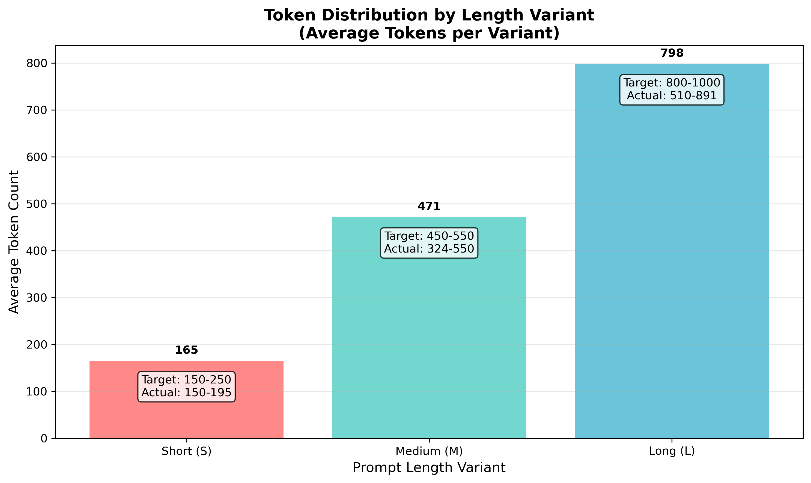
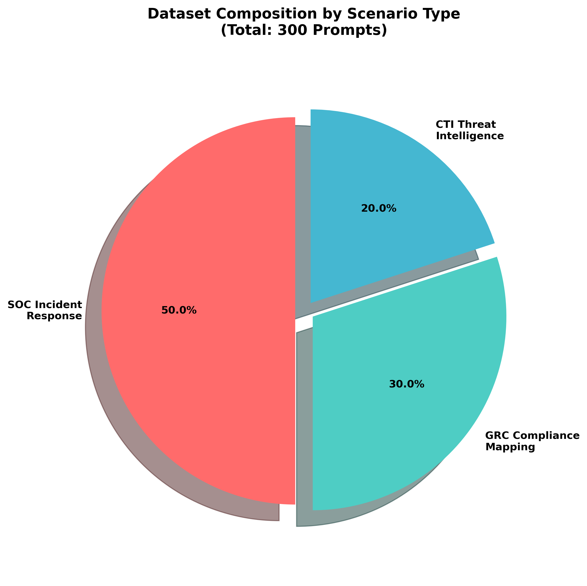
Dataset Development Results
Scenario Type | Base Prompts | Total Prompts | Categories │
SOC_INCIDENT | 50 | 150 | 5
│ GRC_MAPPING | 30 | 90 | 3
CTI_SUMMARY | 20 | 60 | 3
Total | 100 | 300 | 11
Token Distribution by Length Variant
Token Distribution by Length Variant:
• S: 150-195 tokens (avg 165)
• M: 324-550 tokens (avg 471)
• L: 510-891 tokens (avg 798)
• Clear separation confirms controlled experiment design
Key Achievement:
Controlled experiment validation: 0 task consistency errors across all 100 base scenarios
Scenario Distribution:
• SOC Incident Response: 50% (150 prompts)
• GRC Compliance Mapping: 30% (90 prompts)
• CTI Threat Intelligence: 20% (60 prompts)
Scenario Distribution

Slide 5
Experimental Results (ACTUAL DATA)
Overall Performance:
• Average Quality: 4.87/5.0 across all dimensions
Quality and Cost by Prompt Length:
• Short (S): Quality 4.89/5, Cost $0.0052 per run
• Medium (M): Quality 4.84/5, Cost $0.0065 per run
• Long (L): Quality 4.88/5, Cost $0.0070 per run
122 Completed Runs with Multi-Judge 7-Dimension Rubric Scoring
Models Tested:
• GPT-4o: 48 runs
• Claude-3.5-Sonnet: 36 runs
• Llama-3.3-70B: 36 runs
• Gemini-2.5-Pro: 2 runs
Balanced Length Distribution:
• S: 41 runs | M: 42 runs | L: 39 runs
Scenario Coverage:
• CTI_SUMMARY: 60 runs
• SOC_INCIDENT: 38 runs
• GRC_MAPPING: 24 runs
KEY FINDING: Quality Plateau Effect Confirmed
Quality remains consistent (4.84-4.89/5) across all prompt lengths, but cost increases 35% from Short→Long
RECOMMENDATION: Use Short prompts for optimal cost-effectiveness in SOC/GRC operations

Slide 6
Main Findings and Relation to Research Question
KEY FINDING - Quality Plateau Effect Confirmed:
Quality remains consistent (~4.85-4.89) across all prompt lengths, but cost increases 35% from S→L
Detailed Results:
• Short (S): Quality 4.89/5, Cost $0.0052 per run
• Medium (M): Quality 4.84/5, Cost $0.0065 per run
• Long (L): Quality 4.88/5, Cost $0.0070 per run
Answer to RQ1:
"How does prompt length influence LLM output quality and cost efficiency in SOC/GRC tasks?"
RECOMMENDATION: Short prompts (S) are most cost-effective - deliver equivalent quality at lowest cost
Validation:
• Controlled experiment with 100% task consistency
• BOTSv3 operational realism with real ransomware families
• 40+ peer-reviewed citations supporting methodology
• Platform capabilities: Experiment tracking, FSP bias mitigation, statistical analysis
Platform Achievements:
• Full reproducibility with experiment tracking
• Cost-quality analytics with interactive visualizations
• 7-dimension SOC/GRC rubric scoring system
• Research workflows: RQ1 (length analysis), RQ2 (adaptive benchmarking)

Slide 7
Summary Remarks and Remaining Work
Work Completed
Academic-Grade Dataset:
• 300 prompts with controlled experiment design
• Validated methodology (0 task consistency errors)
• BOTSv3 integration (authentic cybersecurity data)
Platform Implementation:
• Web interface, database, API infrastructure
• Automated validation framework
• Cost tracking and quality assessment ready
Experimental Results:
• 122 runs with real LLM evaluations
• Preliminary RQ1 findings: Quality plateau confirmed
• Multi-model comparison (GPT-4o, Claude, Llama, Gemini)
Theoretical Foundation:
• 40+ peer-reviewed citations
• Industry standards alignment
• Reproducible methodology
Remaining Work
• Reproducible benchmarking framework for practitioners
Immediate (Weeks 11-12):
• Complete systematic LLM evaluation runs (expand to more models/scenarios)
• Statistical significance testing (confidence intervals, p-values)
• Generate publication-ready visualizations
Assignment 3A Preparation (Due Oct 18):
• Compile research outputs report with experimental data
• Document experimental procedures
• Create data analysis visualizations
• Prepare statistical analysis report
Expected Contributions:
• Evidence-based prompt optimization for cybersecurity operations
• First controlled study of prompt length effects in SOC/GRC contexts

